Slide 1
Week 7: Adversarial Models or Integral Probability Measures

Slide 2
Models so Far
All models so far used maximum likelihood estimation
Two main directions:
Precise likelihood estimation:
AR and flow-models
Fewer approximations but worse scaling behaviour
Approximate likelihood estimation:
VI and diffusion models

Slide 3
This Week: Model without Point Estimation
This week – consider a next type of model
Will not require implicit likelihood estimation
Potentially allow for more expressive models

Slide 4
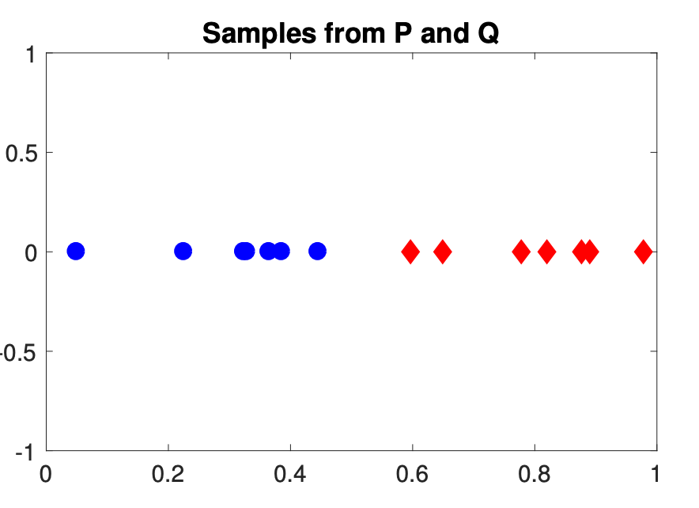
Two-Sample Test
We are given N samples from two distributions p(x) and q(y)
Several questions we can ask:
Are the p and q distributions different?
What is the distance between these distributions?
Statistical test to answer the first question – “two sample test”

Slide 5
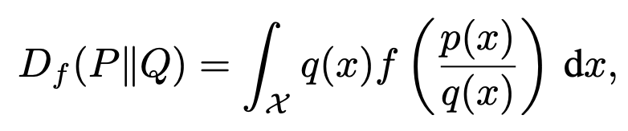
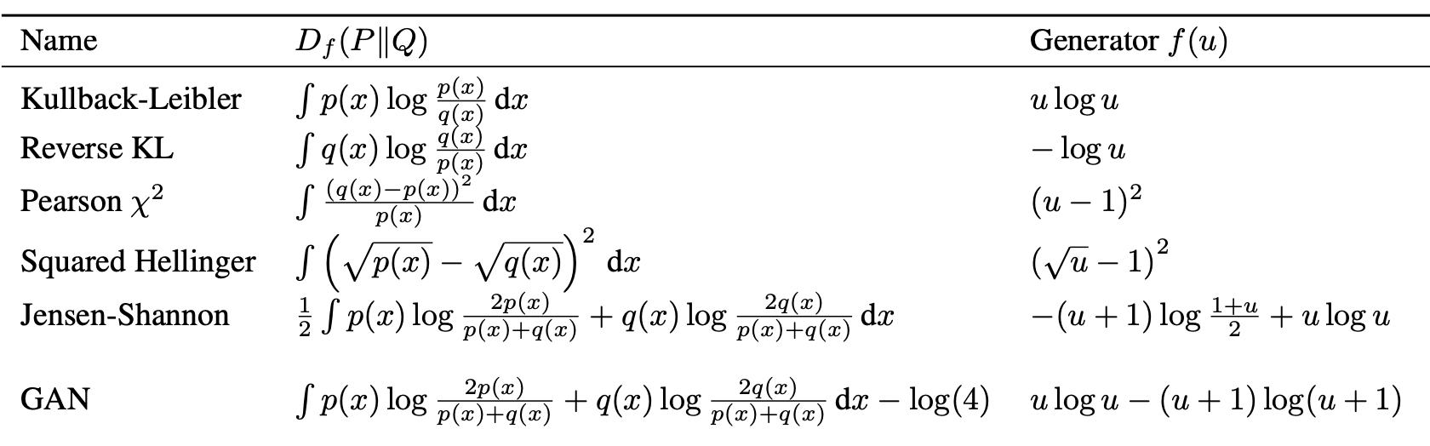
Probability Divergence
A way to measure the difference between the distributions
Does not have to be symmetric
Several famous divergences:

Slide 6
Calculating Divergence Between Samples
How do we compute the divergence between two samples?
Naïve Idea: Estimate p and q, then compute divergence
Very hard as estimation is something we wish to avoid

Slide 7
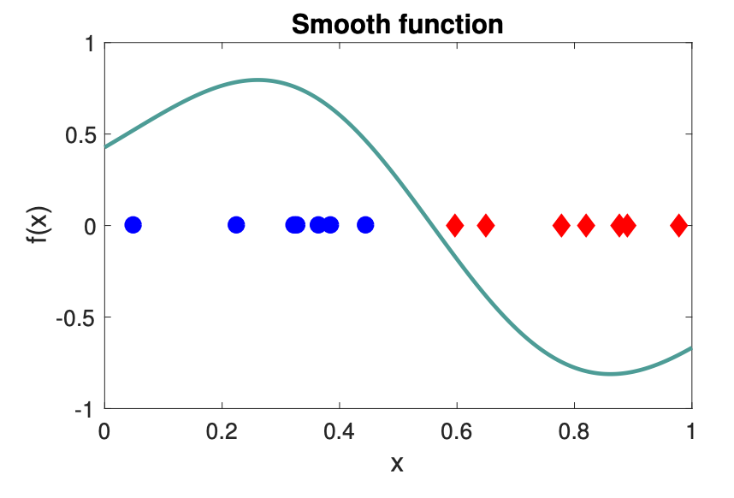
Integral Probability Metrics
Want to compute two sample distance without estimating p,q
Idea - compute a function f(x) which maximizes:

Slide 8
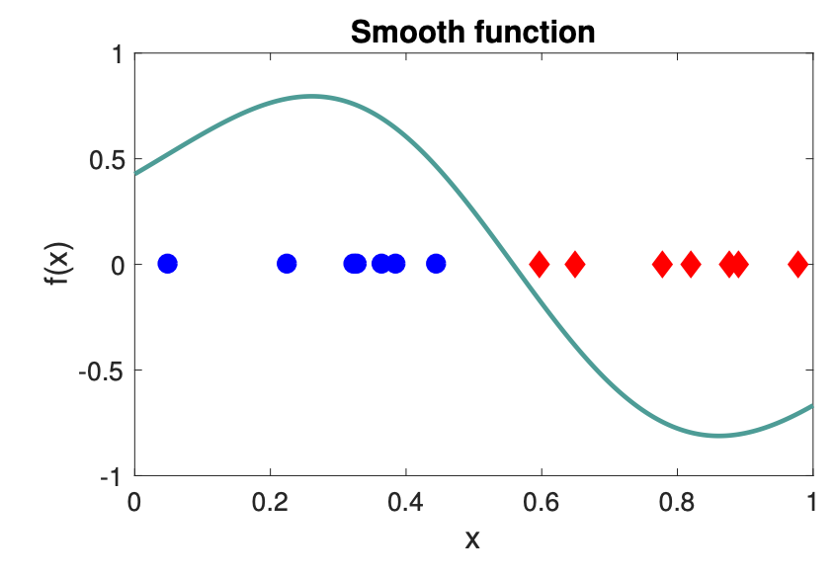
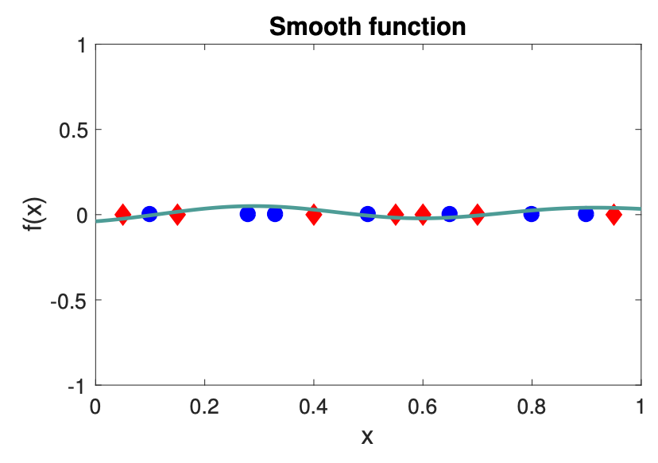
Such IPM Capture Near and Far Samples
The difference is large when P,Q are different and small when near
Wonderful, so we have our two sample test!

Slide 9
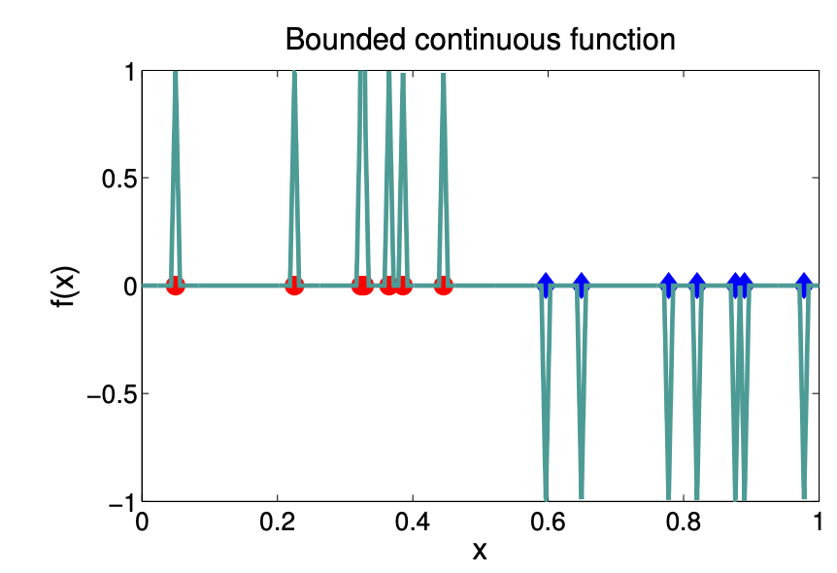
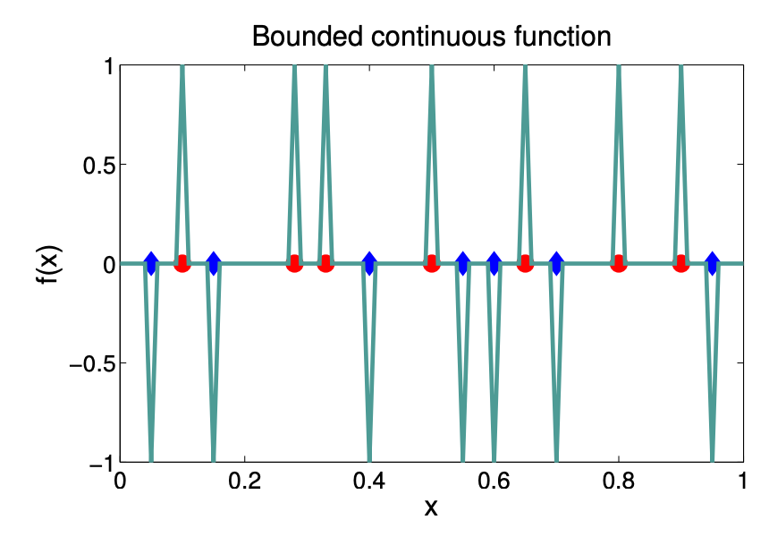
No So Fast
What happens when f(x) is non-smooth?
IPM can have arbitrarily small values – even for very different P,Q

Slide 10
Generative Adversarial Models
Let’s forget the last issue for now
Assume we are given a set of sample x₁,x₂…x_{N} from P
We also have a generator function G, mapping noise to samples Q
E.g. if we sample noise vectors z₁,z₂..z_{N} -> G(z₁),G(z₂)..G(z_{N})
How similar are is the distribution of generated and true samples?

Slide 11
Measuring Generative Models 2-Sample Stats
Idea: measure distance between generated distribution Q(=G(z)) and true distribution P using the 2 sample statistic

Slide 12
Standard GAN Loss
In the standard GAN loss, the IPM is given by:
The function f is called the discriminator
Should have high value for real samples, low value for generated
Lower value of IPM -> harder it is to distringuish generated from real
Notes:
מעבירים סיגמויד כדי לא לתת לf לתת לנקודות לדוגמה של התפלגות אחת ערכים ממש גדולים ולשנייה ממש קטנים (אינסוף ומינוס אינסוף).

Slide 13
GAN Training
Now that we can measure the distance between P and G(Z)
Can we use this to improve G?
Can we find a function G such that distribution G(Z) identical to P?
Optimize G to minimize the IPM!
Notes:
לא פותר את הבעיה. f אופטימלי לא יאפשר למצוא G.

Slide 14

Adversarial Training
This type of training is called adversarial
f is trained to maximally discriminate against G
G is trained to maximally fool f – make it hard to distinguish

Slide 15
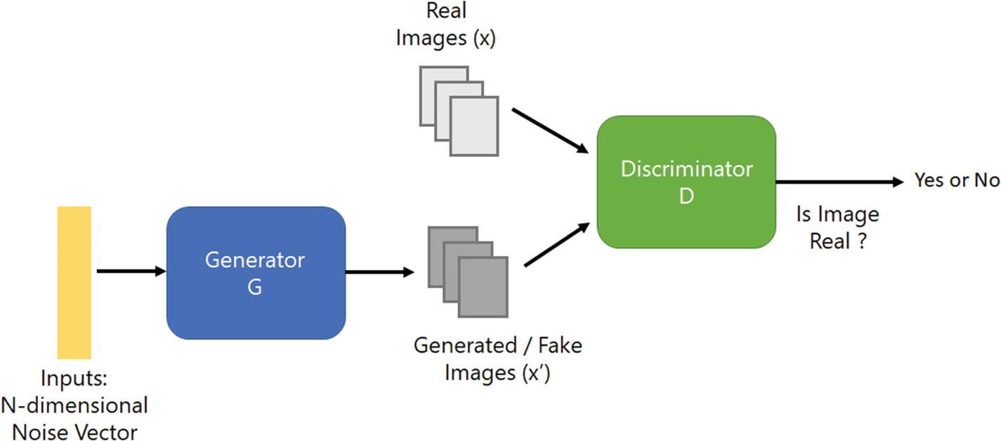
GAN Training for Images
Generator network – maps noise vector to images
Discriminator network – maps image to number
High for real, low ffor generated

Slide 16
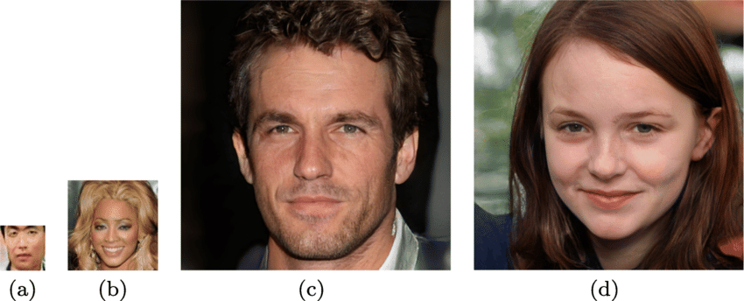
Sampling Using GAN Models
Sampling is very easy
Sample random noise vector from Gaussian distribution
Map to image using generator G

Slide 17
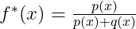
The Optimal Solution to GAN = JS-Divergence
The GAN loss is:
Solving for the optimal f at every x, we obtain:
Subtituing back:
The JS divergence is given by:

Slide 18
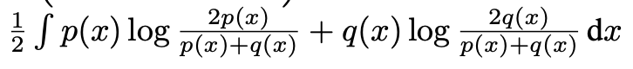
The Optimal Solution to GAN = JS-Divergence
The JS-divergence is given by:
Our expression for the GAN loss:
Can simply be written as:

Slide 19
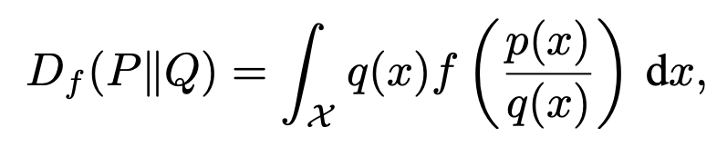
f-GAN: IPM Lower Bound the f-Divergence
It was shown that for divergence
Is lower bounded by the IPM:
Where f* is the Fenchel conjugate of f (don’t worry what this means)

Slide 20
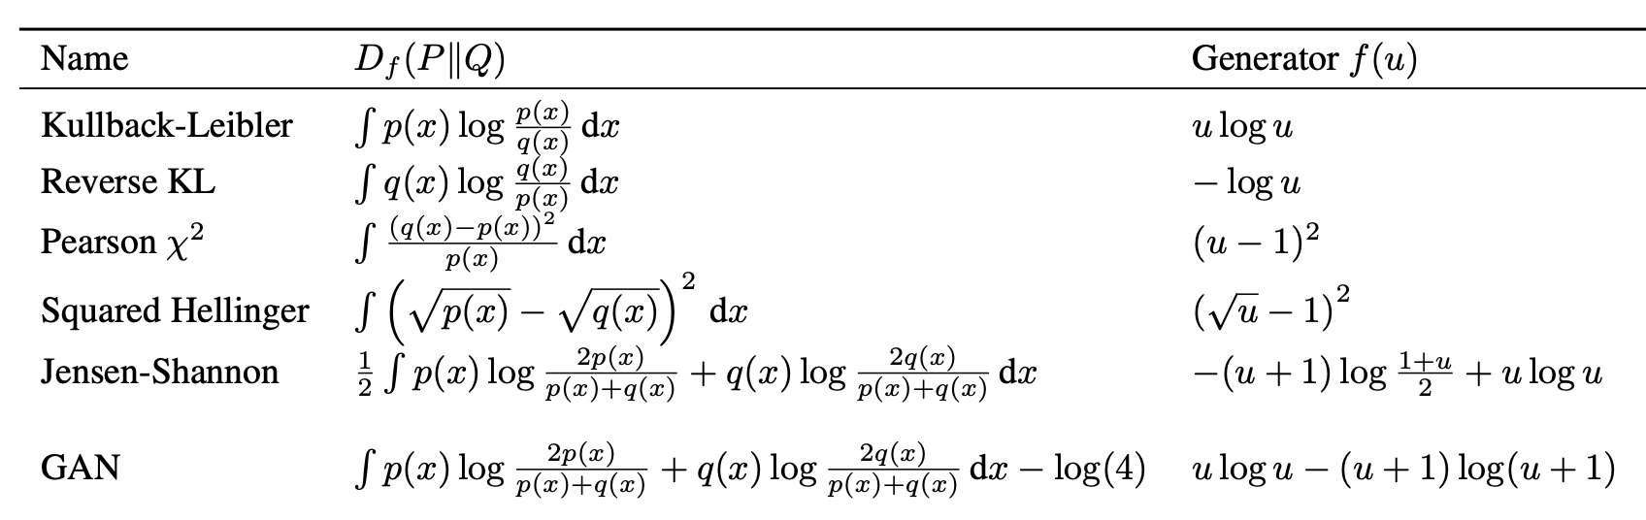
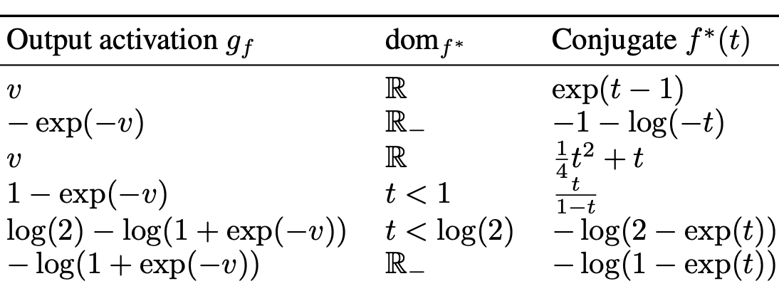
Example of f-GANs
Here are the GAN equivalent of some famous divergences
Standard GAN is also one of them

Slide 21
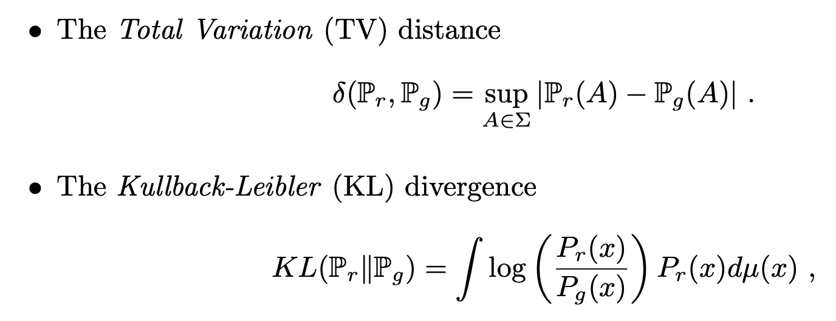
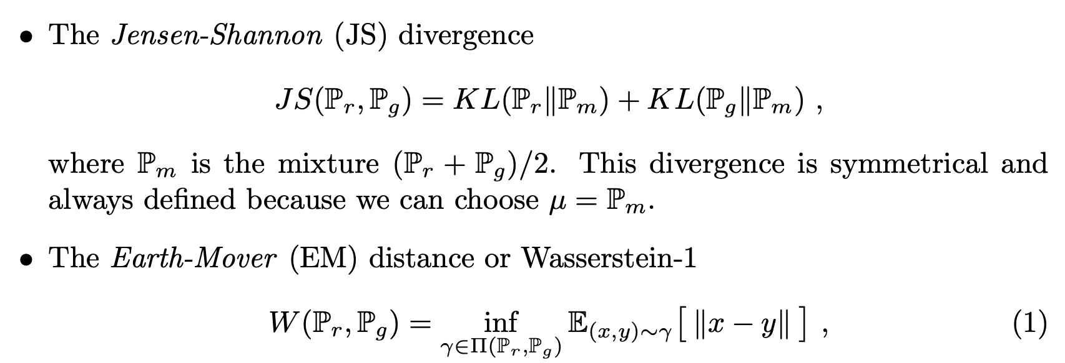
Probability Distance Measures

Slide 22
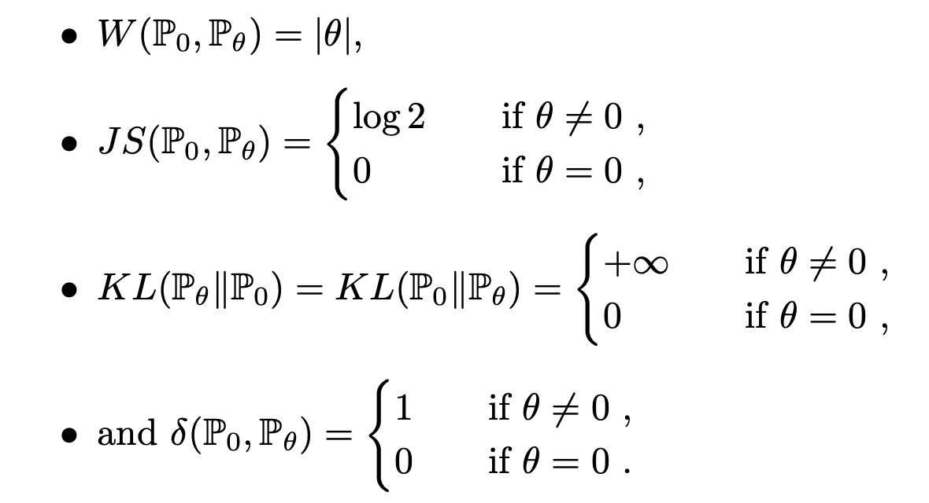
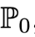
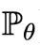
Different distance measures on toy example

Slide 23
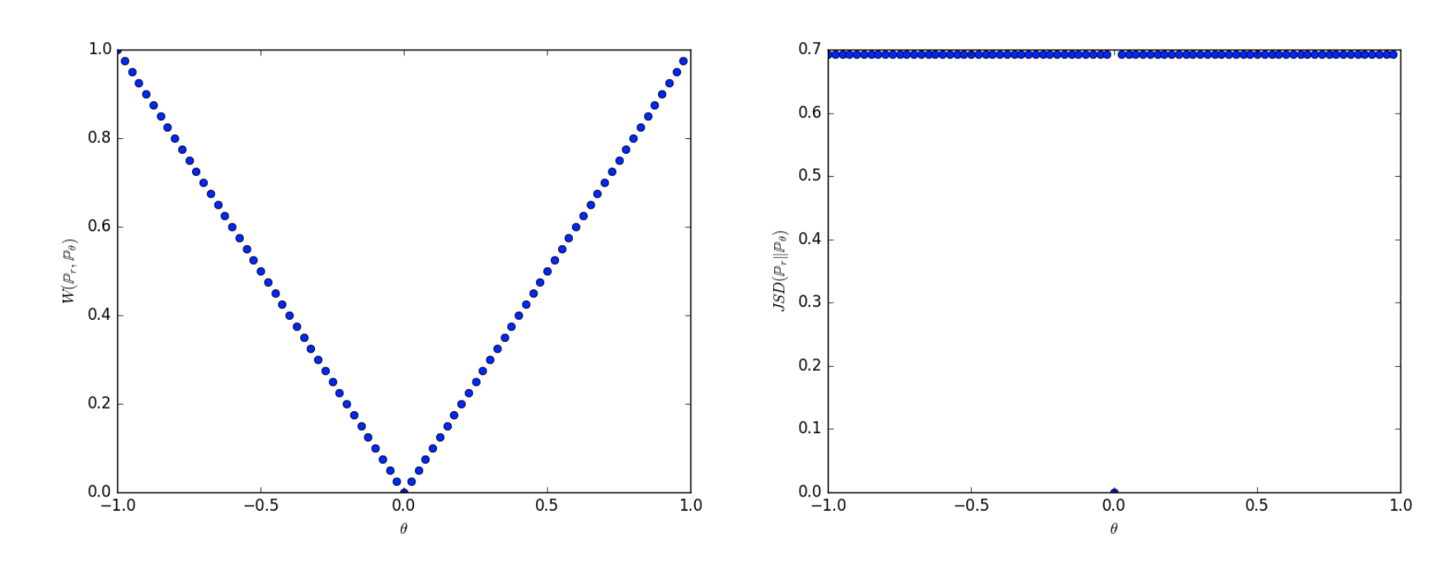
Different distance measures on toy example (2)

Slide 24
What Does All This Mean?
The short story – GANs diverge
If P=Q, then no f can distinguish between them
But this only happens at infinity
For all case where P!=Q:
Choose f(x)=1 for all samples for P (which are finite)
Choose f(x)=0 for all other samples
The above loss will have constant values for many f, gradient 0

Slide 25
Other Divergences

Slide 26
Different divergences on toy example

Slide 27
Different distance measures on toy example (2)

Slide 28
We Need a More Expressive Measure
The above shows that exisiting diverences are not expressive enough
They fail when Q and P have different supports
They do not vary smoothly
Need better ideas!

Slide 29
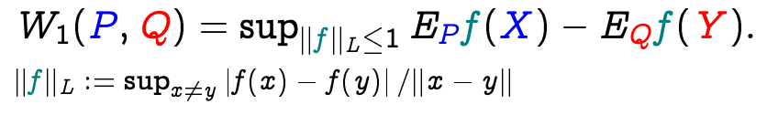
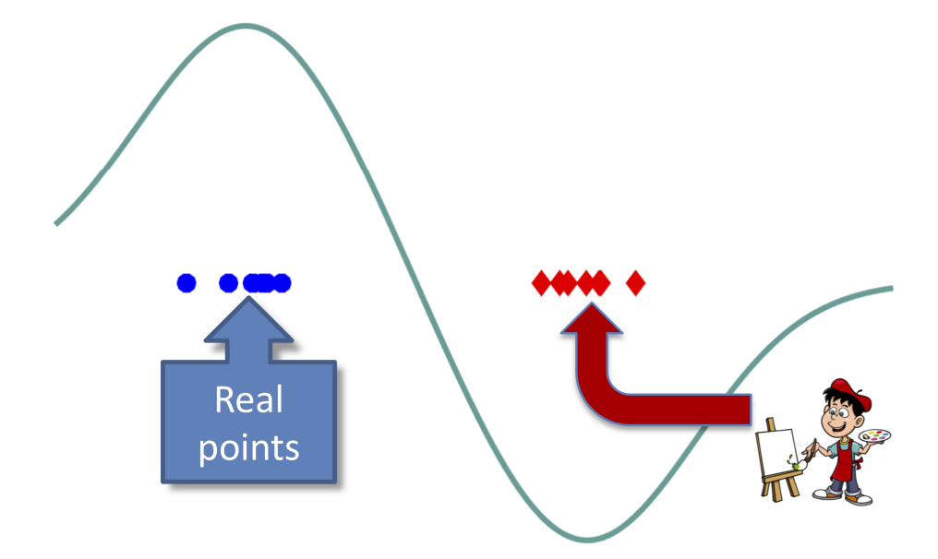
Idea: Enforce Smoothly Varying Function
The key idea: enforce the discriminator function is smooth
This way it will provide gradient at all points
Mathematically: Lipschitzness is a measure of smoothness

Slide 30
Back to the Toy Example
The W-1 distance provides a smooth gradient

Slide 31
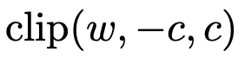
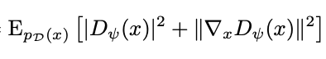
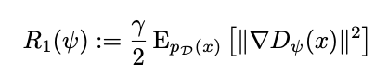
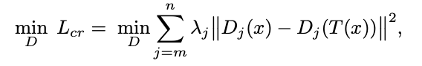
How to enforce Lipschitz-1 function f
WGAN: weight clipping
WGAN-GP:
Mescheder et al.:
Zhang et al.:

Slide 32
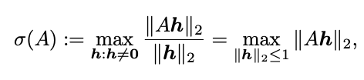
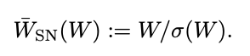
Spectral Normalization
Ensure that every layer in the network is Lip-1
Fast method for speeding up eigenvalue computation based on power method

Slide 33
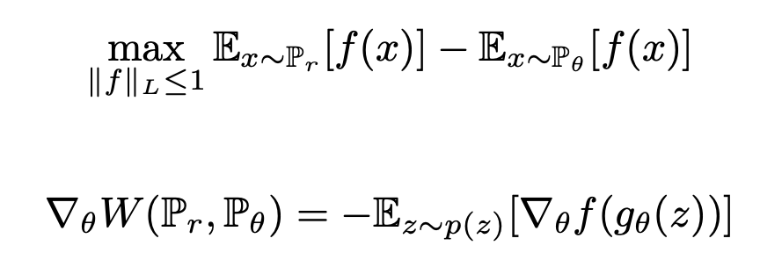
The Wasserstein GAN
Finally this can be seen as an adversarial task:

Slide 34
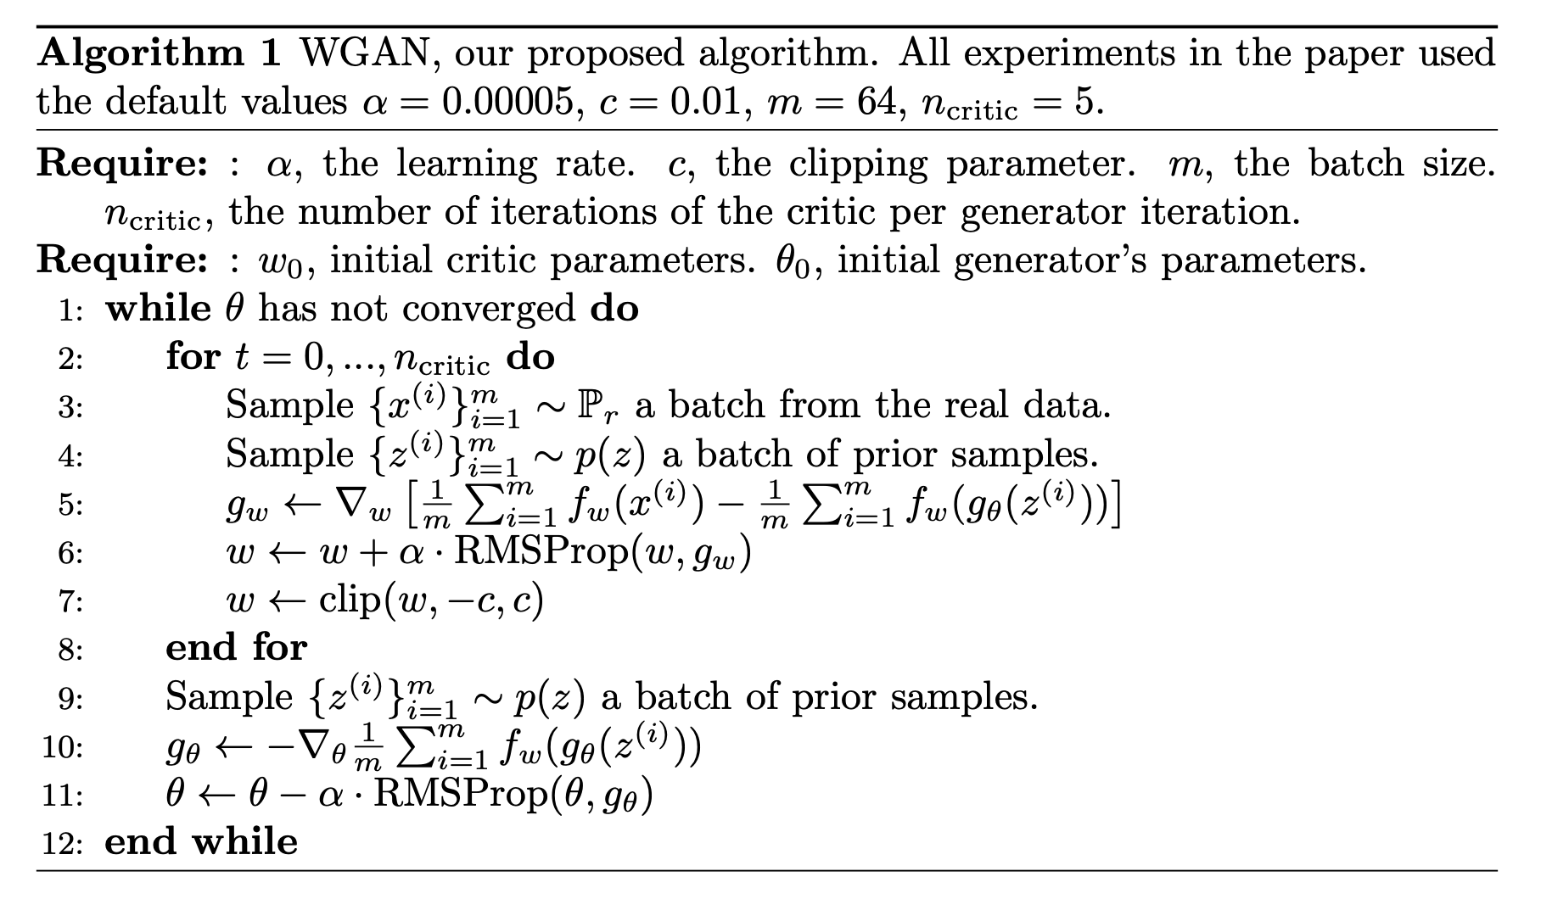
WGAN algorithm

Slide 35
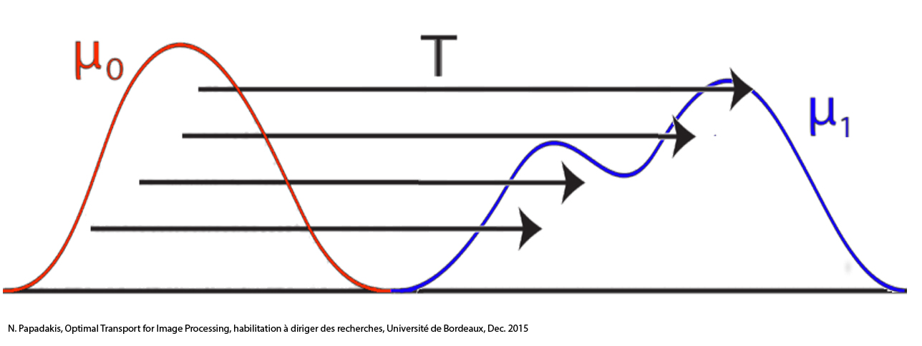
Optimal Transport
The L1-IPM is the dual of the Wasserstein distance
The Wasserstein distance provides optimal matching between samples
In 1-D is is called the Earth Mover’s Distance

Slide 36
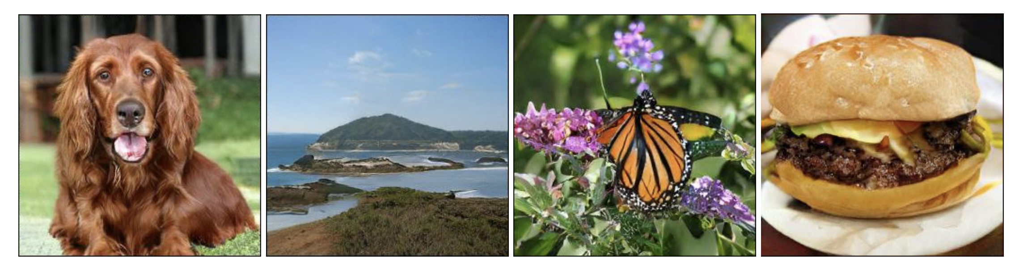
BigGAN
Large Scale GAN Training for High Fidelity Natural Image Synthesis
Andrew Brock, Jeff Donahue, Karen Simonyan - DeepMind
Objective: GAN image generation at the ImageNet scale
A tour-de-force of GAN tricks – not one idea

Slide 37
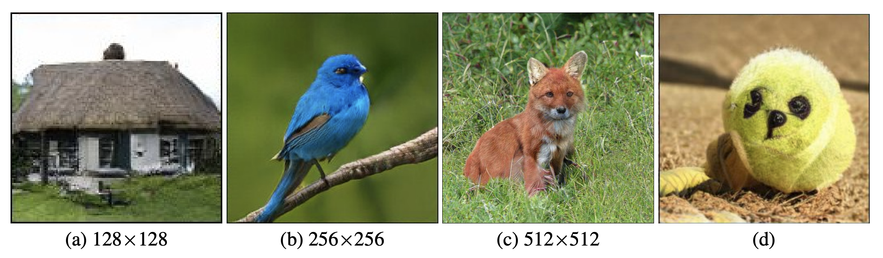
Visual Results

Slide 38
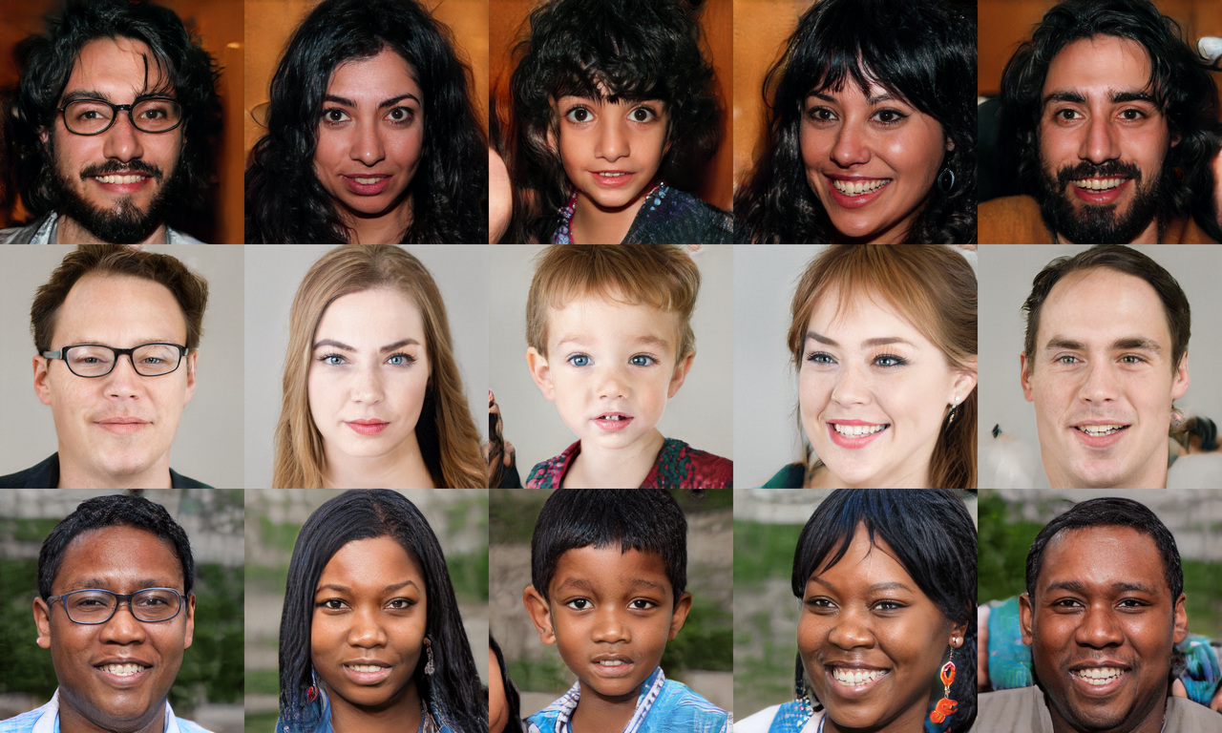
StyleGAN
A Style-Based Generator Architecture for Generative Adversarial Networks Tero Karras, Samuli Laine, Timo Aila - NVIDIA
Objective: model the distribution of a single class
Main idea: inject style code at every level of the generator

Slide 39
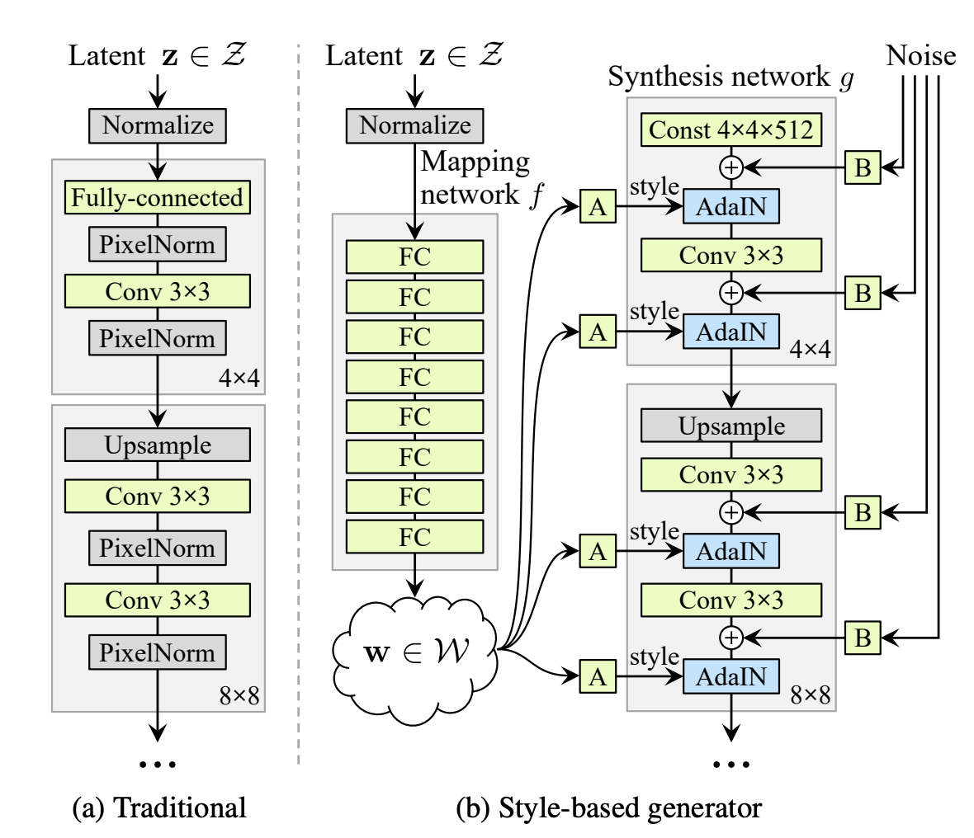
Architecture
Noise to per-layer style code
Contrast with single code in DCGAN
Code injected via AdaIN

Slide 40
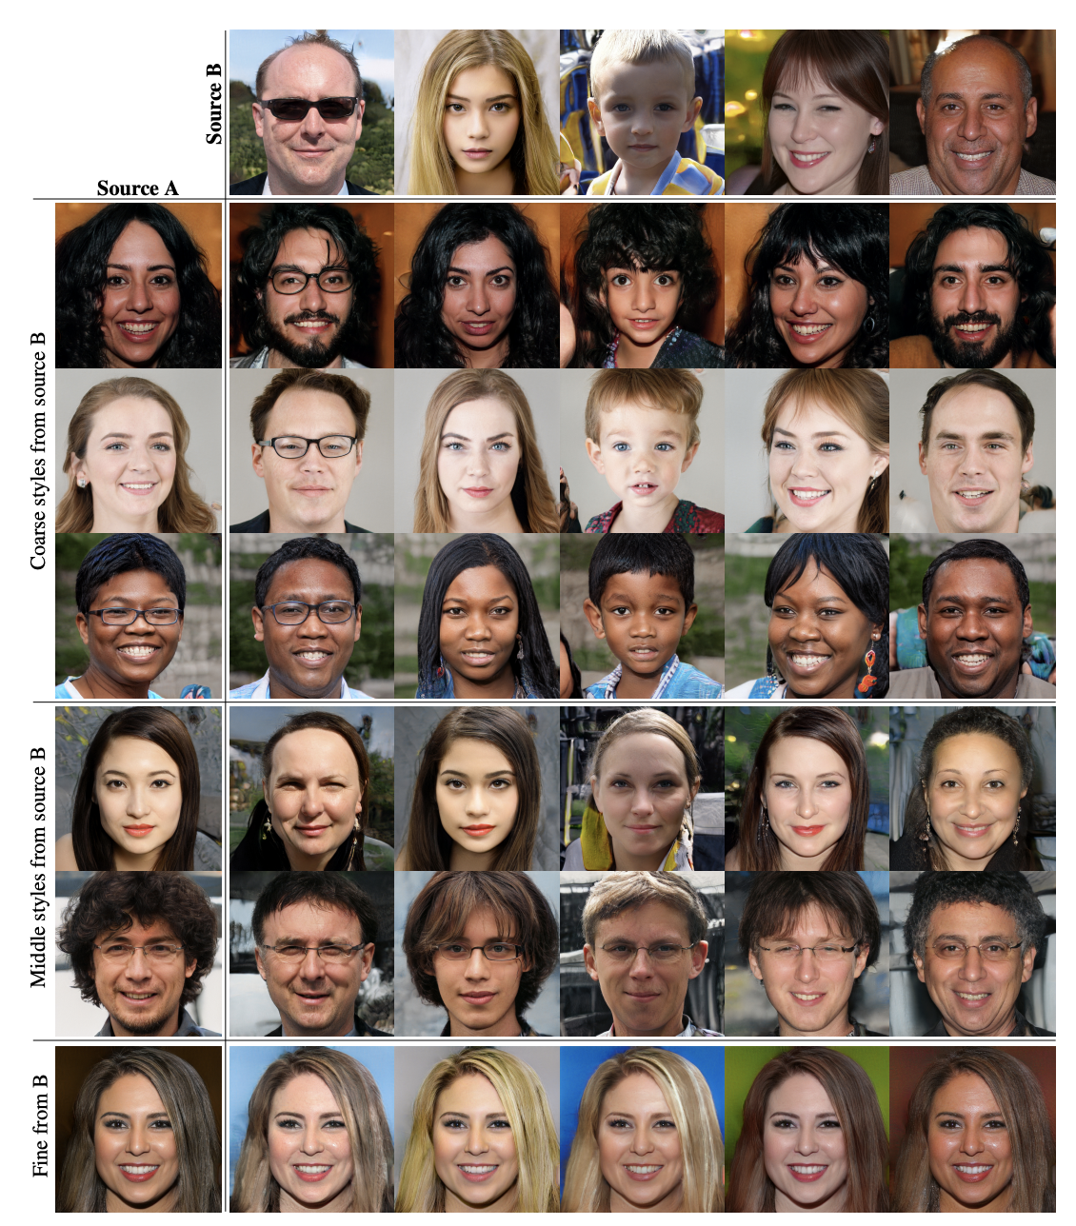
Effective Disentanglement Between Layers
Codes of different layers are responsible for different scales of attributes

